Slide 1

TECHNICAL ANSWERS FOR REAL WORLD PROBLEMS ECE-3999 PROJECT REVIEW
Faculty- Dr. SRS PRABAHARAN

Slide 2
GROUP MEMBERS:
K MANOJ MADHAV - 15BEC1078
M CHANDU NIRMAL - 15BEC1085
A R SAI YASASWI - 15BEC1122
N SHANMUK KUMAR - 15BEC1167
CH NIKHIL CHAKRAVARTHY - 15BEC1184
M HEMANTH AUDISESHA REDDY- 15BEC1208
M S S AVINASH - 14BEC1193

Slide 3
Problem: Maritime Boundary Trespassing by TN Fishermen
Fishermen have been facing a problem of trespassing the maritime border accidentally since ages. In order to get a better catch at the seas, they go farther and farther, near the Katchutheevu island thereby entering the Sri Lankan waters and undergoing the legal procedures of that country. This is a great threat to their family and hence the country.

Slide 4
SOLUTION
We intend to solve the issue by alerting the fishermen based on their location using GPS.
If the boat is very close to the maritime border(as programmed in the device), it will alert the sailor to turn back.
Note: The project has already been designed (non-commercial use) but the solution devised by our team will be much cheaper, efficient and effective.

Slide 5
NATIONAL MARINE ELECTRONICS ASSOCIATION
NMEA sentences start with the $ character, and each data field is separated by a comma.
There are different types of NMEA sentences. The type of message is indicated by the characters before the first comma.
The GP after the $ indicates it is a GPS position. The $GPGGA is the basic GPS NMEA message, that provides 3D location and accuracy data.

Slide 6
COMPONENTS REQUIRED
ATMEGA328p
Neo 6M – GPS Module
Buck Converter(12V – 5V)
AMS1117(5V-3.3V)
Power LEDs
TIP 120
Buzzer

Slide 7
ATMEGA328p
The Atmel 8-bit AVR RISC-based microcontroller combines 32 kB ISP flash memory with read-while-write capabilities, 1 kB EEPROM, 2 kB SRAM, 23 general purpose I/O lines.
Also, 32 general purpose working registers, three flexible timer/counters with compare modes,
Internal and external interrupts,

Slide 8
ATMEGA328p
Serial programmable USART, a byte-oriented 2-wire serial interface, SPI serial port, 6-channel 10-bit A/D converter ,
Programmable watchdog timer with internal oscillator, and five software selectable power saving modes.
The device operates between 1.8-5.5 volts.

Slide 9
NEO 6M GPS MODULE
Ublox Neo 6M (Ublox NEO6MV2) is a I2C compliant GPS module.
This module has an external antenna and built-in EEPROM.
Interface: RS232 TTL
Power supply: 3V to 5V
Default baud rate: 9600 bps
Works with standard NMEA sentences

Slide 10
NEO 6M GPS MODULE
The NEO-6M GPS module has four pins: VCC, RX, TX, and GND.
The module communicates with the Arduino via serial communication using the TX and RX pins.
The GPS module receives the details in the form of NMEA sentences.
These sentences can be either viewed in a serial monitor or can be exploited for our purpose.

Slide 11
CONNECTION WITH ARDUINO
NEO-6M GPS Module | Wiring to Arduino UNO
VCC | 5V
RX | TX pin defined in the software serial
TX | RX pin defined in the software serial
GND | GND

Slide 12
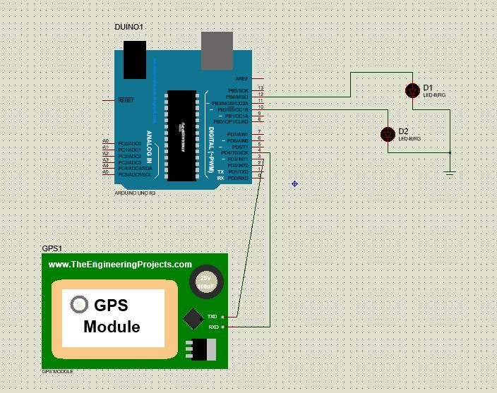
Basic Setup

Slide 13
WORK DONE
RS232 module (for testing) has been used for retrieving coordinates from GPS module.
The GPS module could connect to 14 US satellites and was able to point the current location.
Accuracy of the GPS module has been checked and verified by using the software tool named u-Center. It is developed by the manufacturer of the GPS module named Ublox.

Slide 14
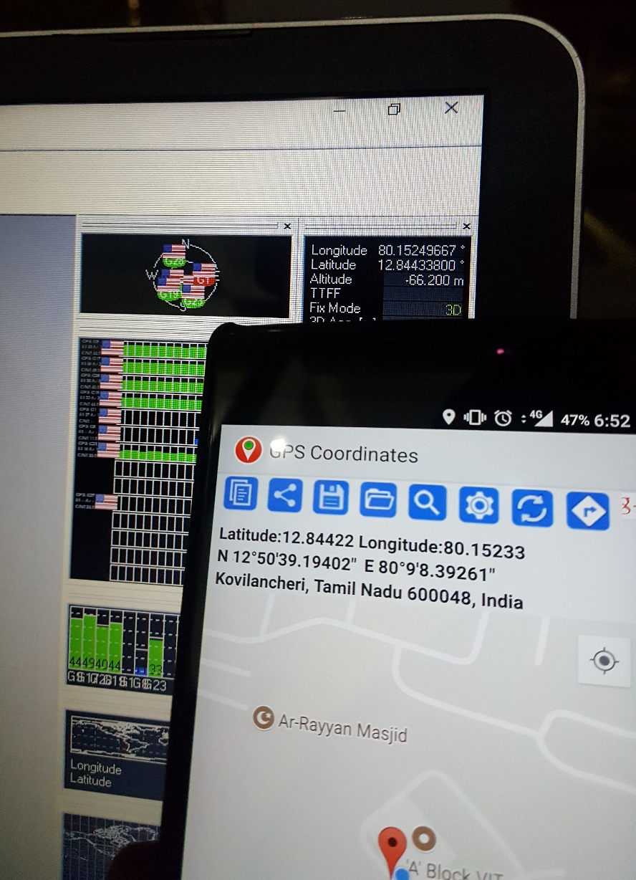
VERIFICATION OF COORDINATES

Slide 15
WORK DONE
An Arduino code has been designed to retrieve the coordinates from the GPS module and continuously send to the microcontroller at regular intervals.
These coordinates, are actually viewed as NMEA sentences in a serial monitor.
Indian maritime boundary coordinates have been identified.

Slide 16
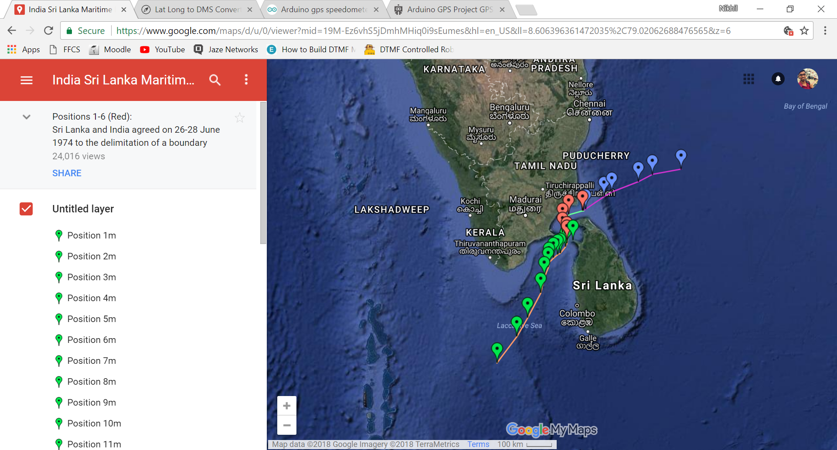
INDIAN MARITIME BORDER COORDINATES

Slide 17
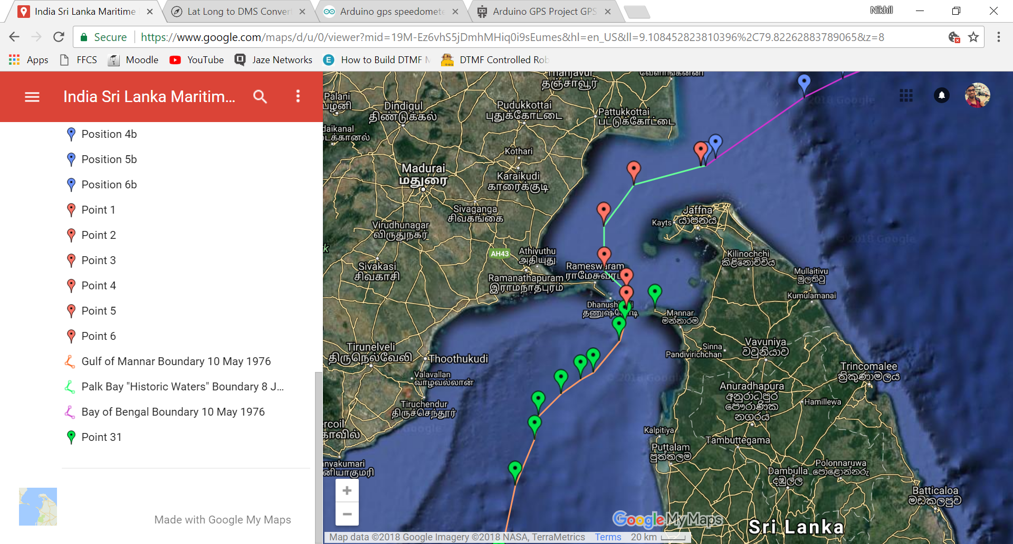
VIOLATION PRONE AREA

Slide 18
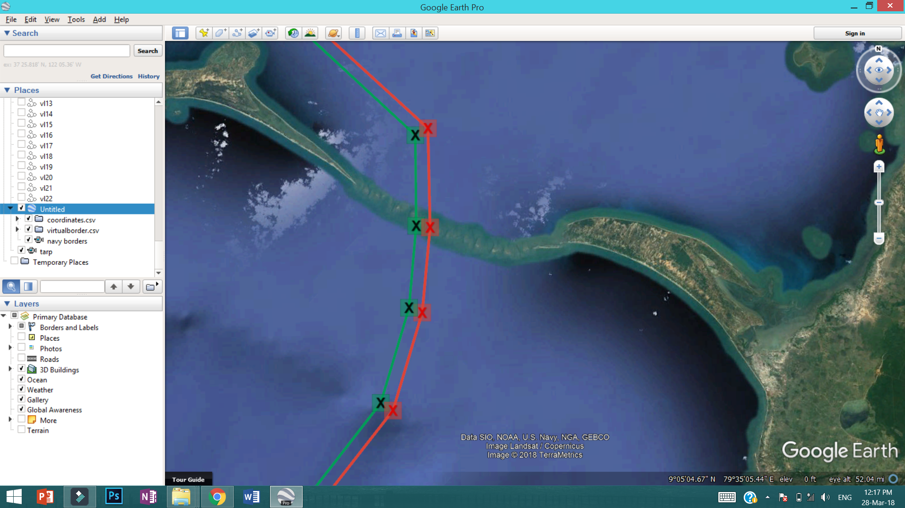
Virtual Border and Real Border

Slide 19
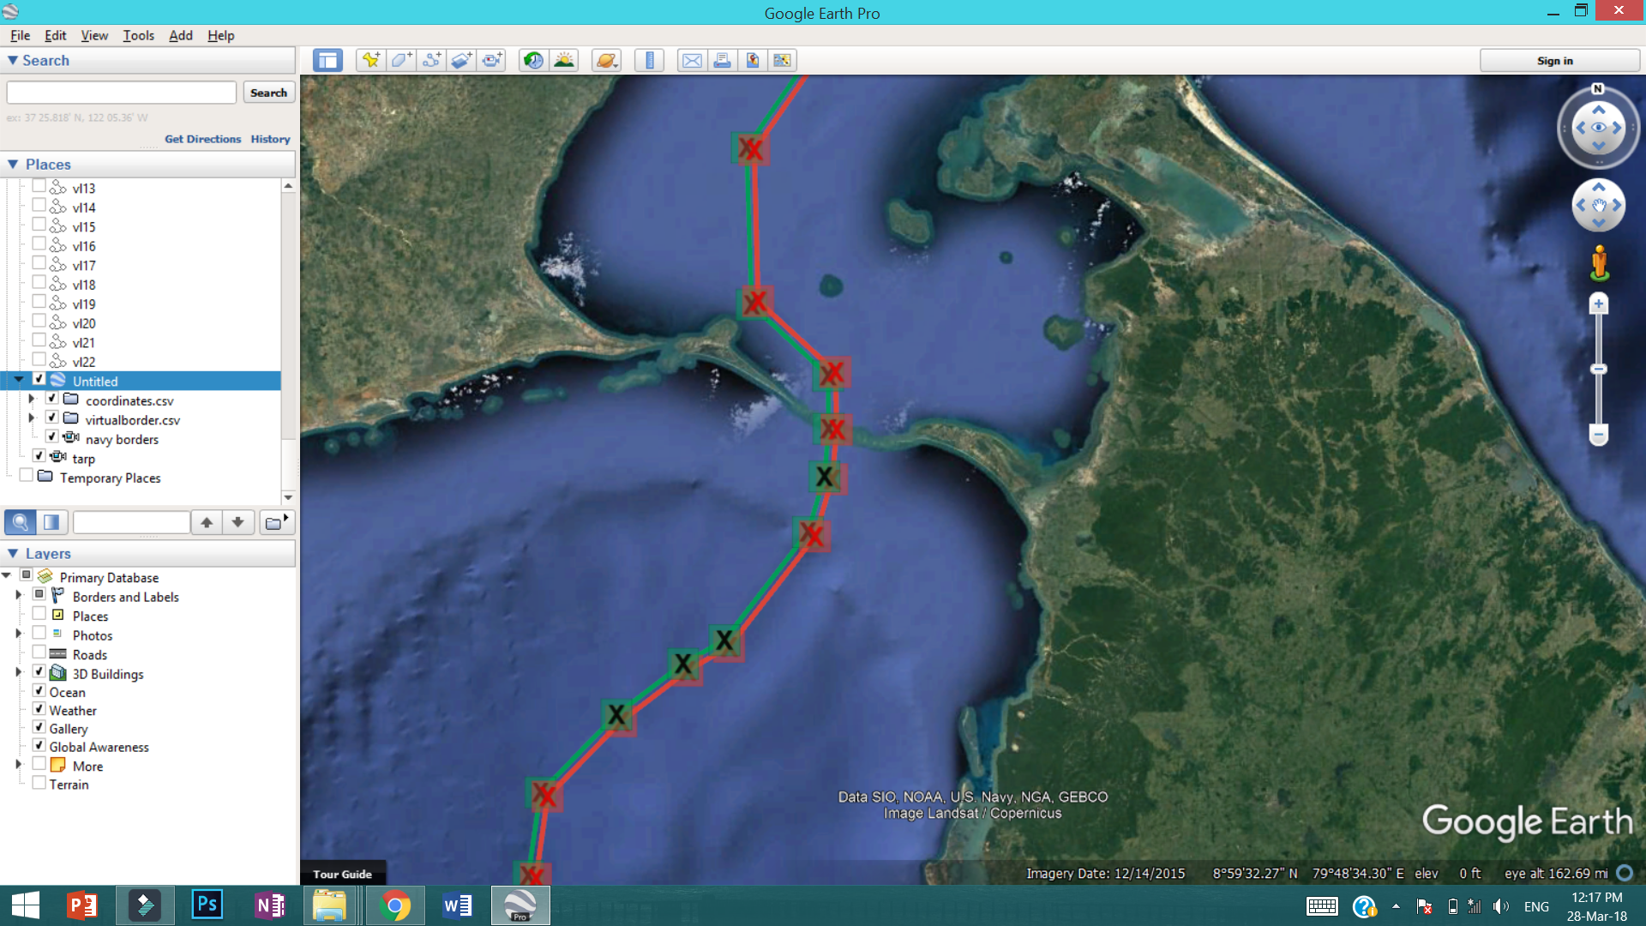

Slide 20
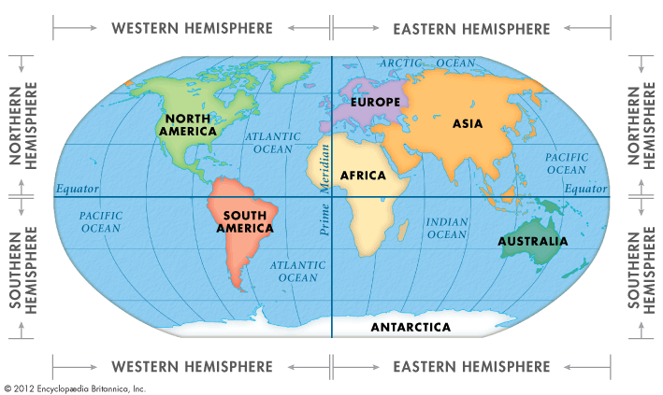
Coordinates and Coding.

Slide 21
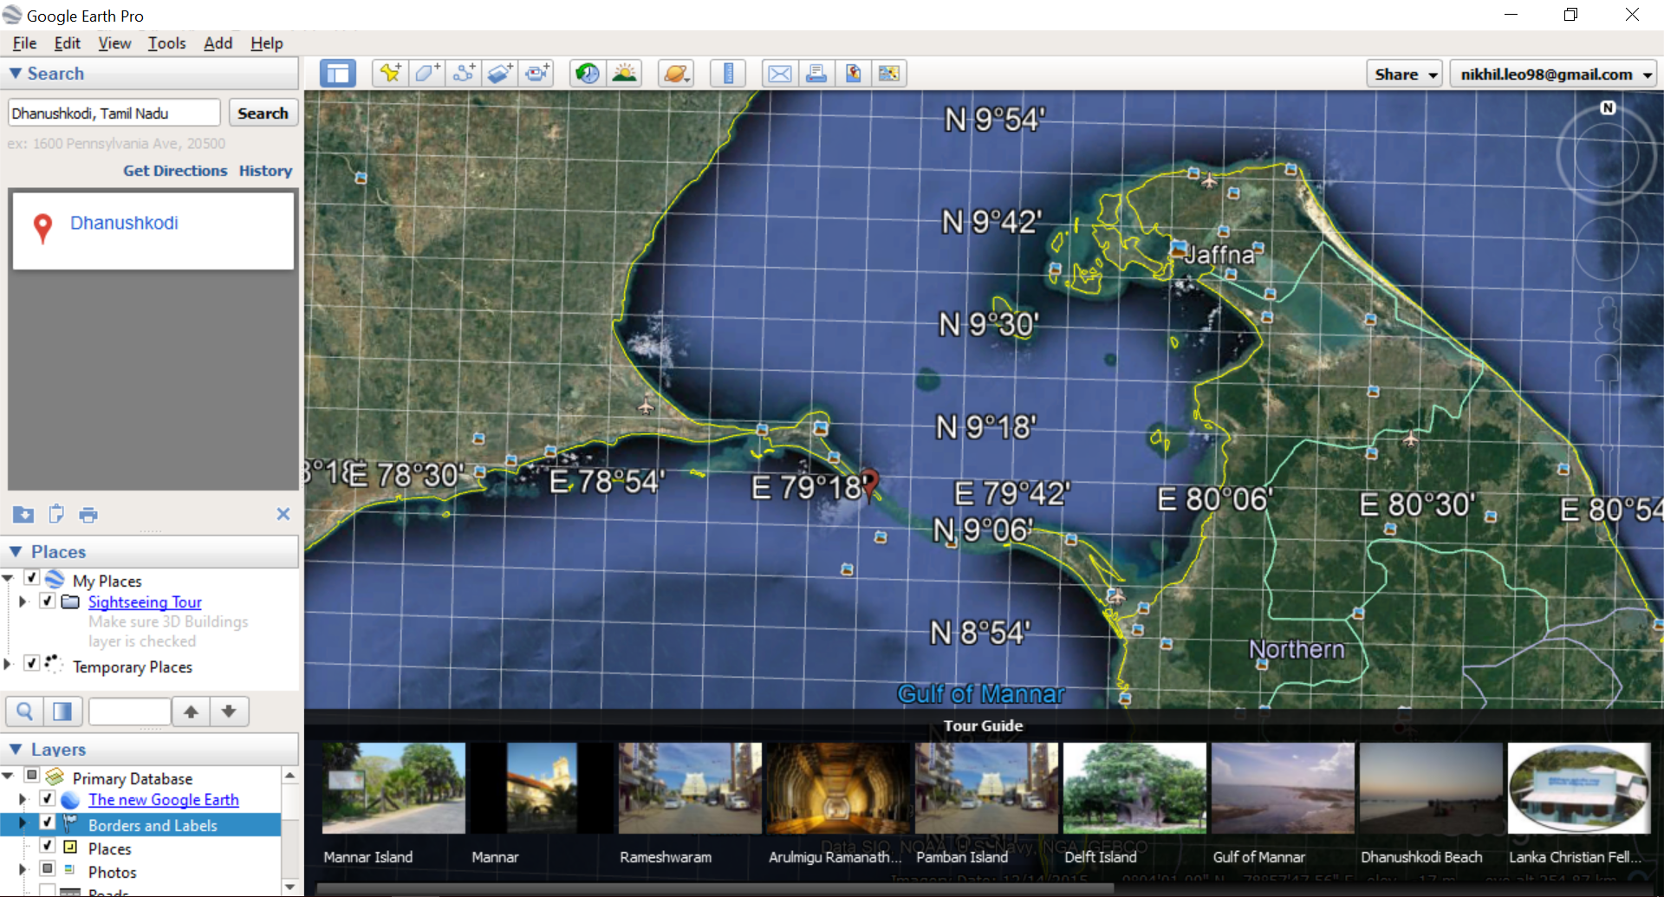
Coordinates Variation

Slide 22
METHODOLOGY
23 coordinates in degree, minutes and seconds have been converted into decimals.
22 Line equations have been formed using the 23 Border coordinates(with accuracy up to 6 decimals).
These line equations currently serve as the indication only.
Threshold coordinates and their corresponding line equations have to be designed.
A testing boundary has been created at MGR Statue

Slide 23
SOLUTION
This border will serve as the threshold border.
If any vehicle crosses this threshold border, it is forced to shut down.
But, the main complication is that we have to manually feed all the coordinates into the code which is a very complex process as they vary both in terms of latitude and longitude in a non-linear manner.

Slide 24
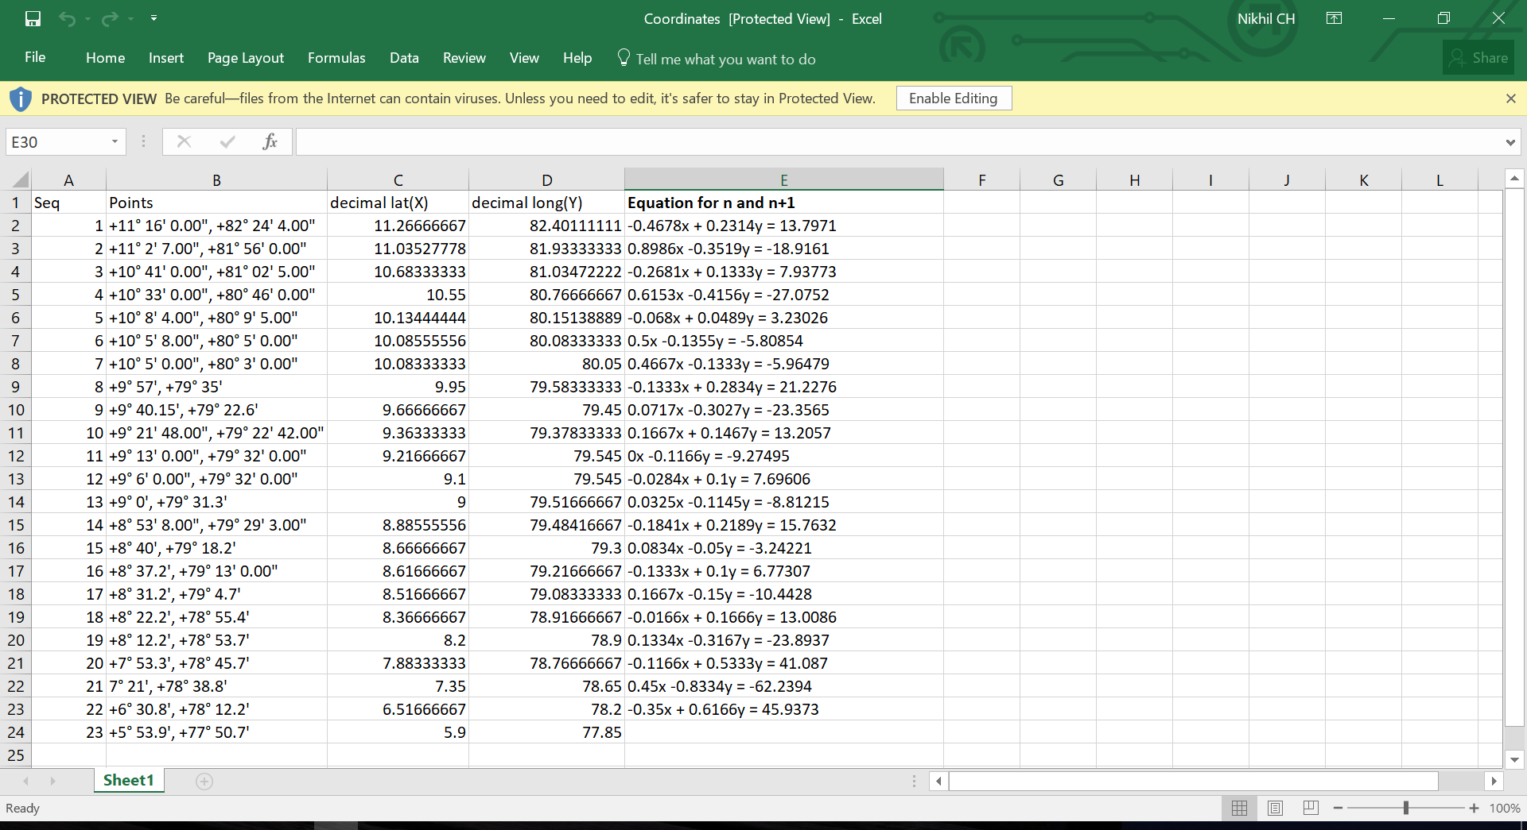
LINE EQUATIONS

Slide 25
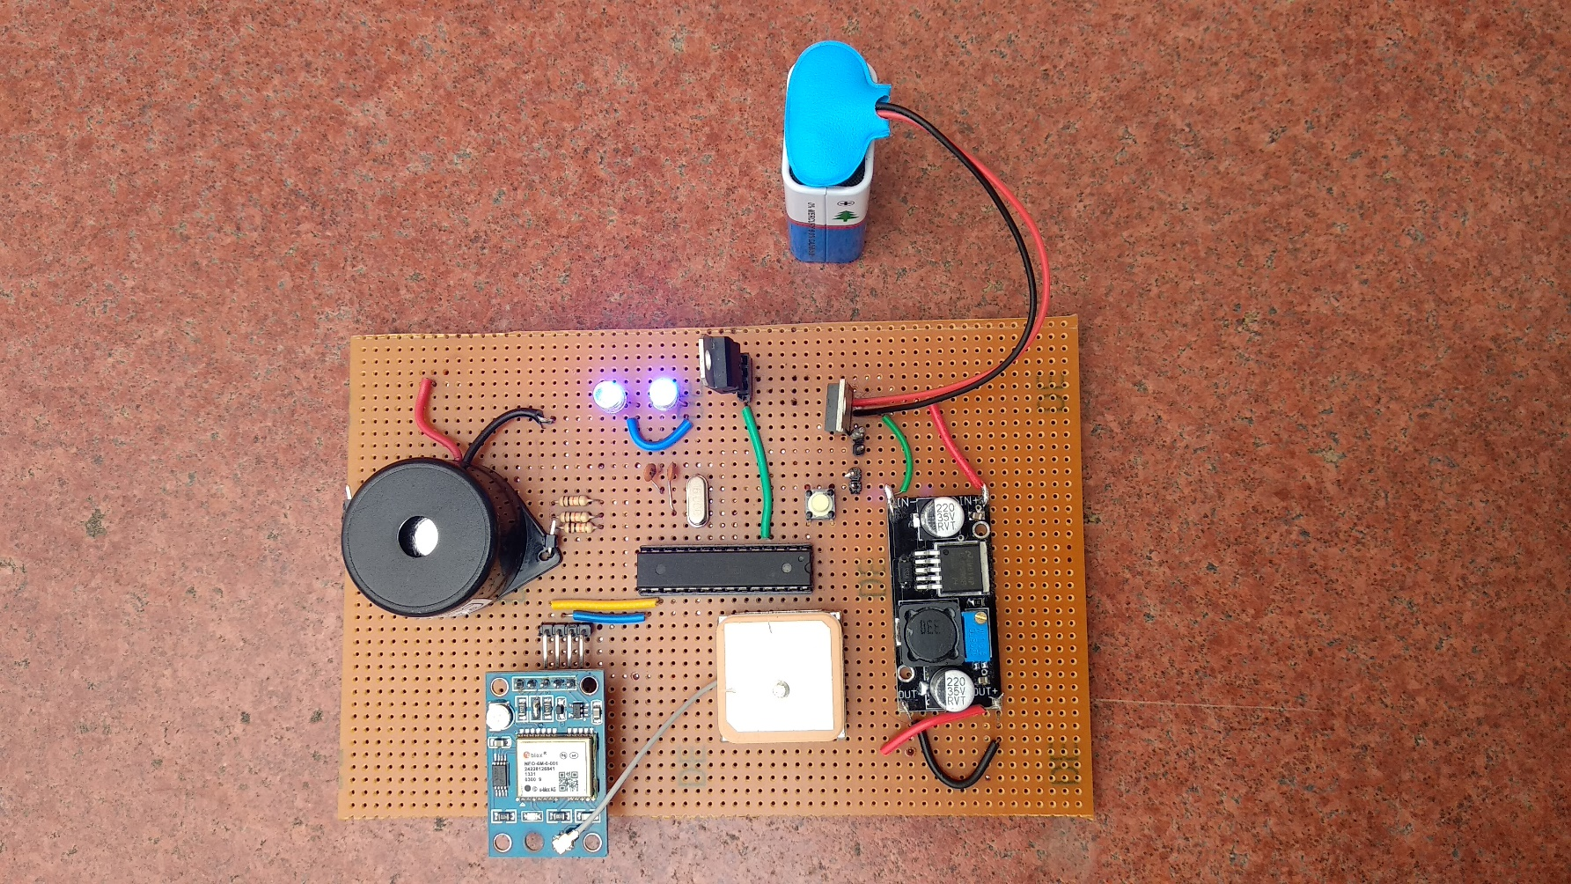
WORKING PROTOTYPE

Slide 26
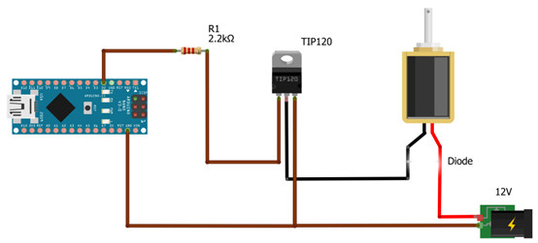
Solenoid Addition

Slide 27
Thank You ☺

